Slide 1
University of California Center for Medicinal Cannabis Research
Presentation to California Senate Committee on Business, Professions and Economic Development
March 13, 2023
Igor Grant, MD, Director
J. Hampton Atkinson, MD & Thomas D. Marcotte, PhD, Co-Directors
Robert Fitzgerald, PhD, Bioanalytical Laboratory Director
David Grelotti, MD, Medical Director
Jeremiah Momper, PhD, Reference Lab Director
Jennifer Marquie-Beck, MPH, Director of Research Operations
www.cmcr.ucsd.edu

Slide 2
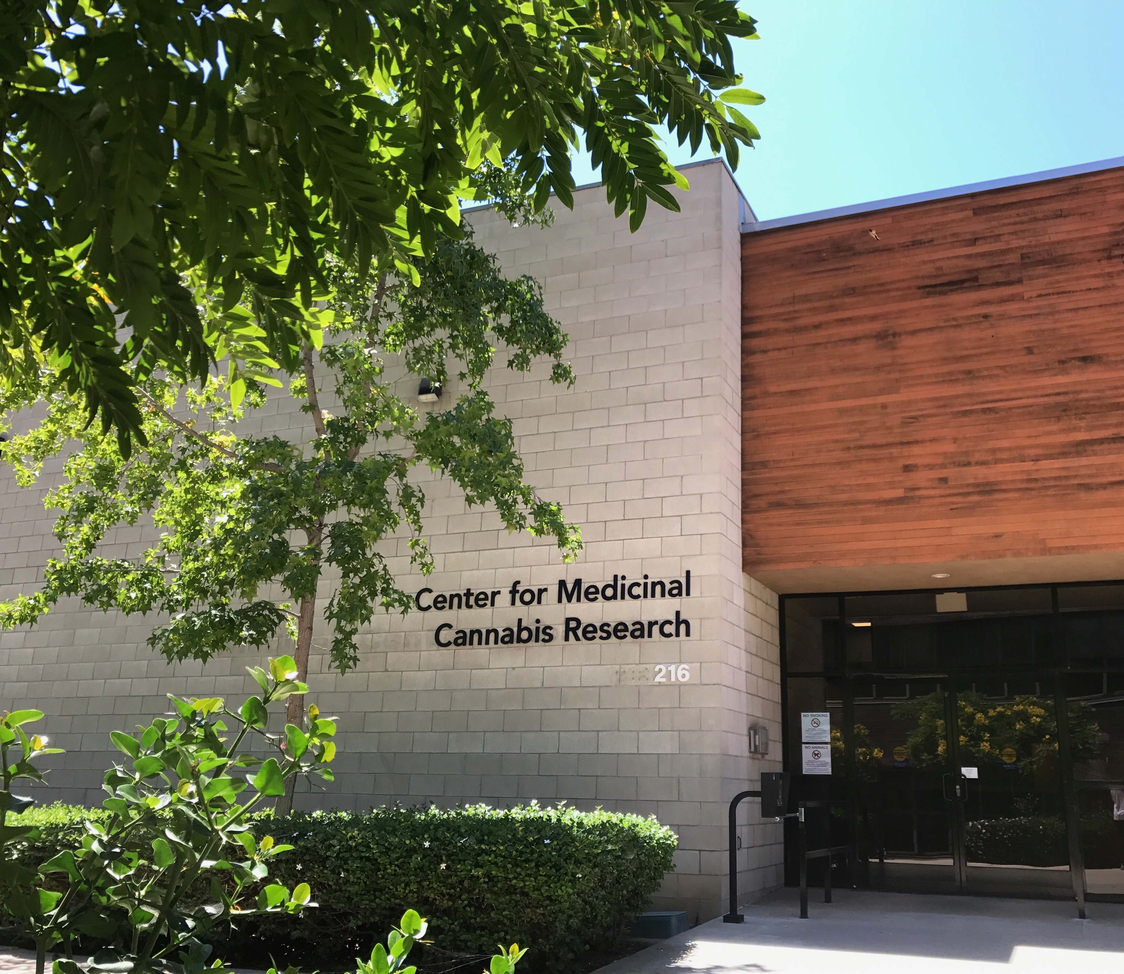
Center for Medicinal Cannabis Research
1996 Compassionate Use Act
1999 Medical Marijuana Research Act (SB 847; SB 295: Vasconcellos): authorizes CMCR; defines objectives
2000 CMCR established
2016 Adult Use of Marijuana Act (Prop 64) – $2M annual funding to CMCR
Mission
Facilitate high quality scientific studies
Ascertain the safety and efficacy of cannabis and cannabinoid products
Advance cannabis/cannabinoid science via development of common measures, data and sample repositories, laboratory analytics
Provide authoritative evidence-based information to practitioners, educators, policy makers, public

Slide 3
CMCR Expertise and Resources
Regulatory Expertise: Federal, State, institutional IRB (human subjects)
Clinical Research Expertise: study design, statistical analysis, specimen collection, cross-study standardization enabling data aggregation
Drug Procurement: identify and negotiate with sources of cannabinoids, including for human clinical trials
Data Management and Information Systems: web-based data management and reporting, hardware/software resources, enabling of big data analysis
Specimen Collection, Processing and Storage: Blood, oral fluid, breath, spinal fluid, urine, stool; specimen repository (24-hour temperature monitoring), custom web-based inventory system
Laboratory Medicine Resource: Mass-spectrometry and other methods to evaluate cannabis metabolites, endocannabinoids, added biomarkers in human samples and tissues; develop capability to evaluate plant and other products
Facilities and Equipment: Negative pressure rooms (inhaled cannabis), driving simulation rooms, clinical exam rooms, cognitive testing equipment
Reference Laboratory: Serves as a resource to CA Dept of Cannabis Control to examine content of cannabis products

Slide 4
CMCR Research Mission CMCR facilitates medicinal cannabis research via
Direct funding of California scientists conducting medicinal cannabis research : ~$1.3M annually (CMCR Grants Program) * All submissions evaluated by national experts
“Primary” $825K over 3 years
“Pilot” $300K over 2 years
Providing extensive, unique resources which enable CMCR affiliated investigators to compete successfully for funding beyond the CMCR grants program, e.g.,
Federal agencies, e.g., NIH
Other State programs
Professional associations
Philanthropic organizations

Slide 5
CMCR allocation* of Prop 64 funds (FY18/19 – FY22/23)
CMCR Grants Program | $6,625,000
Core Research Support** | $2,850,000
Administrative Support | $525,000
TOTAL | $10,000,000
* Projections to end of FY22/23 rounded to nearest thousand
**Core Research Support: CMCR Bioanalytical Lab (measures cannabinoids and endocannabinoids); Biospecimen Repository; consultation on proper specimen collection and storage; consultation on study design; guidance on regulatory issues; procurement of cannabinoids for use in human studies; data repository; annual CMCR Symposia; monthly CMCR scientific meeting; scientific publication/presentation; mentoring trainees; community engagement

Slide 6
CMCR allocation of $10M in Prop 64 funds (FY18/19 - FY22/23)
Core Research Support:
CMCR Bioanalytical Lab (measures cannabinoids and endocannabinoids); Biospecimen Repository; consultation on proper specimen collection and storage; consultation on study design; guidance on regulatory issues; procurement of cannabinoids for use in human studies; data repository; annual CMCR Symposia; monthly CMCR scientific meeting; scientific publication/presentation; mentoring trainees; community engagement
CMCR Grants Program
$6,625,000
5 Primary Grants
(3 yrs, $825K each)
7 Pilot Grants
(2 yrs, $300K each)
1 Pilot Grant (2 yrs, $400K)
Core Research Support
$2,850,000
Administrative Support ($525,000):
Management of CMCR Grants Program
Coordination of CMCR activities
Notes:
* Core Research support: CMCR Analytical Lab (measures cannabinoids and endocannabinoids); Biospecimen Repository; consultation on proper specimen collection and storage; consultation on study design; guidance on regulatory issues; procurement of cannabinoids for use in human studies; data repository; annual CMCR Symposia; monthly CMCR scientific meeting; scientific publication/presentation; mentoring trainees; community engagement

Slide 7
CMCR Grants Program: total awarded since inception in FY18/19 = $6,625,000
Investigator | Topic | Instit. | Funding
Butowski | CBD/anxiety/pain/glioblastoma | UCSF | $300,000
Cadenhead | Cannabidiol/Early Psychosis | UCSD | $825,000
Cahill | Terpenes/analgesia | UCLA | $300,000
Cherner | Cannabidiol/Insomnia | UCSD | $825,000
Cooper | Cannabigerol/THC/analgesia/appetite | UCLA | $825,000
de Guglielmo | Cannabidiol/alcohol dependence | UCSD | $300,000
DiPatrizio | Cannabis/gut barrier function | UCR | $300,000
Frank | Cannabidiol/Anorexia Nervosa | UCSD | $300,000
Ortiz | Cannabidiol/metabolic syndrome | UCM | $300,000
Pettus | THC/type 2 diabetes | UCSD | $825,000
Piomelli | Phytocannabinoids/sickle cell disease | UCI | $400,000
Ranganath | Cannabidiol/Rheumatoid Arthritis | UCLA | $825,000
Taffe | Cannabinoids/opioid abuse | UCSD | $300,000
Davis
Merced
San Francisco
Los Angeles
Irvine
Riverside
San Diego

Slide 8
Proposition 64 CMCR funding is a catalyst for additional research funding
National Institutes of Health
$17M
Reference Laboratory
$11M
Foundation Support
$5.2M
State of California, Other
(Senate Bill, DCC)
$2.9M
CMCR Grants Program
$1.3 M
CMCR Core
Support
$700K
Prop 64 $2 M

Slide 9
Current and Pending CMCR Studies
Vaporized THC/CBD for migraine (take-home study)
Vaporized cannabis in neuropathic pain
Cannabigerol, THC, CBD in pain
Effects of cannabis in sports related injuries in elite athletes
CBD for anxiety and pain in patients with glioblastoma
Terpenes as novel analgesics (rodent)
CBD in severe childhood autism
Effects of THC and CBD on endocannabinoids in bipolar
CBD for alexithymia
CBD in schizophrenia
CBD for anorexia nervosa
CBD for sleep disorders
Effects of THC and CBD on attenuating opioid abuse and addiction (rodent)
CBD to reduce alcohol craving (rodent)
Cannabis on antiretroviral therapy pharmacokinetics and neurotoxicity
Cannabis, cognition and the endocannabinoid system in HIV
Cannabis, inflammation, and the brain in HIV
CBD in rheumatoid arthritis
Cannabis on sickle cell disease (rodent)
CBD effects on blood pressure and metabolic syndrome (rodent)
THC effects on Type 2 diabetes
THC effects on gut barrier function (rodent)
Cannabis Consumption and Driving Impairment Assessment on a Closed Course
Effects of commercially-available products on driving
Pain
Psychiatric &
Substance Abuse
HIV
Other Medical
Driving

Slide 10
Center for Medicinal Cannabis Research Supporting Information Exchange and Education
Provide authoritative evidence-based information to practitioners, educators and policy makers
International (e.g., Canada House of Commons, Thai Govt./researchers, Govt. of Mexico)
Federal/National (e.g., FDA hearing on CBD, House Veterans Affairs Committee, advising legislators proposing cannabis research bills, consultation with other States on medicinal cannabis issues)
State (e.g., G. Newsom’s Blue Ribbon Commission on Marijuana Policy, Medical Board of California, Veterinary Board, California Highway Patrol, Office on Traffic Safety, Department of Cannabis Control, various Legislative offices)
Local (e.g., county supervisors, mayors, councils, law enforcement)
Foster training and educational activities, eg., fellowship program
CMCR Annual Scientific Symposium; monthly Investigator Meetings
Maintain up to date information on CMCR website www.cmcr.ucsd.edu

Slide 11
University of California Center for Medicinal Cannabis Research
Presentation to California Senate Committee on Business, Professions and Economic Development
March 13, 2023
Igor Grant, MD, Director
J. Hampton Atkinson, MD & Thomas D. Marcotte, PhD, Co-Directors
Robert Fitzgerald, PhD, Bioanalytical Laboratory Director
David Grelotti, MD, Medical Director
Jeremiah Momper, PhD, Reference Lab Director
Jennifer Marquie-Beck, MPH, Director of Research Operations
www.cmcr.ucsd.edu

