Slide 1
CERTIFICATION in Animal Chiropractic by the
Animal Chiropractic Certification Commission (ACCC) of the
American Veterinary Chiropractic Association (AVCA)
© 2025 AVCA/ACCC

Slide 2

Gerald Johnson, DVM
University of Florida – Doctor of Veterinary Medicine (1982)
Certification: Animal Chiropractic – ACCC/AVCA (2002)
Certification: Veterinary Acupuncture – IVAS (1992)
Certification: Traditional Chinese Veterinary Medicine (2006)
Certification: Homeopathy (2002)
Silverthorn Animal Clinic, Springhill, Florida (1982-current)
Small Animal Medicine, Surgery, and Alternative Veterinary Medicine
University Of Florida Veterinary College Admissions Committee (2018-2024)
Weekly radio show (pet health and preventative care) WWJB, Brooksville, Florida
American Veterinary Medical Association (AVMA)
Florida Veterinary Medical Association (FVMA)
Society of Theriogenology (SFT)
American Veterinary Acupuncture Association (AVAA)
International Veterinary Acupuncture Association (IVAS)
American Veterinary Chiropractic Association (AVCA)
Board Director 2018-2021
Secretary-Treasurer 2021-2023
President Elect 2023-2025
Education Committee 2018-Current
Animal Chiropractic Certification Commission (ACCC)
ACCC Commissioner 2016-2018
Examiner 2012-current
© 2025 AVCA/ACCC

Slide 3
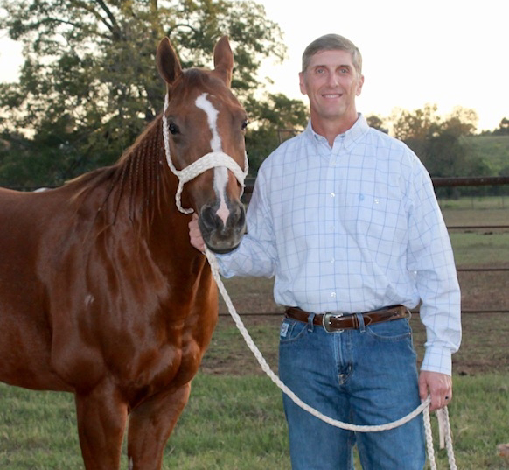
Jon Zeagler, DC
Logan College of Chiropractic – Doctor of Chiropractic (2000)
Carrick Institute/Chiropractic Neurology Diplomat (2000)
Certification: Animal Chiropractic – ACCC/AVCA (2011)
Trinity Chiropractic Clinic, Natchitoches, Louisiana
2000-2019 (Owner)
Trinity Integrated Health and Wellness Center, Natchitoches, Louisiana
2019-current (Owner)
Louisiana Board of Chiropractic Examiners (LBCE) 2009-2021
Board 2009-2013
Secretary/Treasurer 2014-2016
President 2018-2020
Past President 2020-2021
National Board of Chiropractic Examiners (NBCE) 2015-2020
Examiner and Test Committee
American Veterinary Chiropractic Association (AVCA)
President Elect 2016–2018
President 2018–2021
Immediate Past President 2021-2023
Education Committee 2016 - current
Animal Chiropractic Certification Commission (ACCC)
Examiner 2014-current
Chiropractic Association of Louisiana (CAL)
Board of Directors 2006-2008
© 2025 AVCA/ACCC

Slide 4

American Veterinary Chiropractic Association (AVCA)
Animal Chiropractic Certification Commission (ACCC)
AVCA Education Committee
What is Certification
  Difference Between Professional Certification & Curriculum Certificate
Basic Program Requirements
Professional Practice Analysis (PPA)
  Certification Examination
ACCC/AVCA Certified Doctors
Overview
© 2025 AVCA/ACCC

Slide 5
American Veterinary Chiropractic Association
(AVCA)
Animal Chiropractic Certification Commission
(ACCC)
Professional Practice Analysis
Certification Examination
AVCA
Members
AVCA Certified Doctors
AVCA Education Committee
Basic Program Approval
Program Graduates Eligible to sit ACCC Certification Examinations
Seminar Approval for Recertification CE

Slide 6
American Veterinary Chiropractic
Association (AVCA)
A professional not-for-profit membership organization (established 1989) comprised of licensed doctors of veterinary medicine and licensed doctors of chiropractic
Promotes animal chiropractic to professionals and the public
Acts as the certifying agency for doctors who have undergone post-graduate animal chiropractic training
Membership and Certification are separate entities
© 2025 AVCA/ACCC

Slide 7
Animal Chiropractic Certification Commission (ACCC)
An administratively independent certification body of the AVCA
Implements and maintains a certification program that promotes quality in animal chiropractic
Promotes the highest standards in animal chiropractic care for the protection and benefit of the patient as well as the public
ACCC/AVCA is the primary national credential for this field in North America
© 2025 AVCA/ACCC

Slide 8
AVCA Education Committee
Develops approval criteria for animal chiropractic institutions of higher education
  used for purposes of determining eligibility of graduates for ACCC/AVCA certification
  and for advising regulatory/licensure bodies regarding acceptable animal chiropractic training programs
Reviews program provider and program applications
  grants approvals for institutions that meet such criteria,
  and revokes approvals when institutions fail to comply with current approval criteria
Advises AVCA regarding issues/policies/positions regarding animal chiropractic education/training
© 2025 AVCA/ACCC

Slide 9
What is Certification
Certification is a voluntary process by which a non-government entity grants a time-limited recognition and use of a credential to an individual after verifying that he/she has met predetermined and standardized criteria
Certification is distinct from licensure in that it is voluntary and requires recertification to maintain the credential
Certification in animal chiropractic was developed based upon input and oversight from both professions
Certification establishes and promotes professional accountability and visibility
Professional certification is different from a curriculum certificate program
© 2025 AVCA/ACCC

Slide 10
Difference between
Professional Certification and Curriculum Certificate
Professional Certification
Non-governmental program
Delivers an assessment based on industry knowledge
Independent from training courses or course providers
Grants a time-limited credential
Examination is not used as a mirror, but as a screen, to separate those who meet the assessment standards from those who do not
Primary focus is on assessment
Curriculum Certificate
A non-degree granting program
Purpose is to educate participants
Course of instruction with intended learning outcomes
Evaluates participants learning outcomes via an examination
Awards curriculum certificate only to those who have passed that specific examination
Primary focus is on education/training
https://www.credentialingexcellence.org/Accreditation/New-to-Accreditation/Certificate-vs-Certification
© 2025 AVCA/ACCC

Slide 11
AVCA Basic Program Provider Requirements
The institution must comply with all applicable local, state or provincial licensing requirements.
Each basic program is required to provide a minimum of 210 certified hours.
To admit both licensed Doctors of Chiropractic and Doctors of Veterinary Medicine.
The basic animal chiropractic curriculum certificate program graduates must be prepared to obtain consent, evaluate, provide a report of findings, arrive at and communicate a clinical assessment, and treat neuromusculoskeletal and biomechanical conditions of animal patients.
  All graduates must be competent in the common activities as described by the Professional Practice Analysis of the AVCA and must be able to demonstrate diversified chiropractic adjustments with intent to move joints of the animal’s spine beyond the usual physiological range of motion using a fast, low amplitude thrust.
AVCA basic program provider approval is granted for a 2-year period.
https://www.animalchiropractic.org/avca-approved-post-graduate-programs/
© 2025 AVCA/ACCC

Slide 12
Professional Practice Analysis (PPA)
Purpose of conducting a practice analysis (a.k.a. job analysis or job task analysis) is to provide the foundation of a certification examination by defining practice in a profession
Primary method used by assessment professionals to identify and prioritize the important tasks of a job or profession and the essential knowledge or skills required to perform the essential job functions satisfactorily
ACCC/AVCA PPA
  Currently under review by David Starmer, BSc (Hons), DC, MHS, Director of Education, Year III, Education Coordinator SIM Lab and research team at Canadian Memorial Chiropractic College (CMCC), Ontario
  First completed in 2010, reviewed in 2016 and 2017, updated in 2018, Delphi process in 2011 to determine examination scope statement
    Conducted by Douglas M. Lawson, DC, MSc, Psychometrician (University of Calgary, Faculty of Medicine, Medical Education Research Unit), Canadian Chiropractic Examining Board (1985-2003) and Mrs. Maria Lawson, Chief Executive Officer Canadian Chiropractic Examining Board (2003-2013), Alberta
https://www.animalchiropractic.org/wp-content/uploads/2020/01/AVCA-PPA-2019.pdf
© 2025 AVCA/ACCC

Slide 13
Certification examination
Purpose is to assure the public and the profession that candidates who pass are safe for practice in the field of animal chiropractic
Strive to meet standards set by the American Psychological Association
Professional Practice Analysis is examination blueprint
Current and valid standards provide reliable indicators of competence and safety for the protection and benefit of the public
Consists of written and practical components
  Written examination designed to test clinical abilities, as well as knowledge
  Practical examination designed to test the candidate’s performance in a clinical setting to safely adjust
Examination under continuous review and refinement
For more information https://avcaexam.regstep.com/
© 2025 AVCA/ACCC

Slide 14
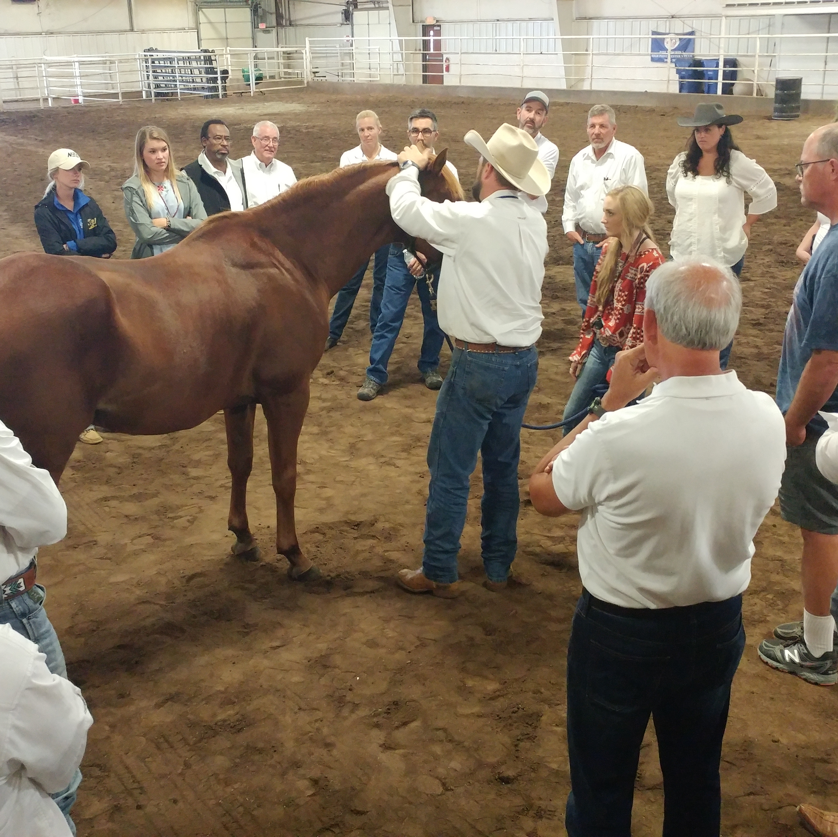
ACCC/AVCA
Certified doctors
Licensed doctor of veterinary medicine or a licensed doctor of chiropractic
Successfully completed an AVCA approved postgraduate basic animal chiropractic program
Passed the ACCC/AVCA certification examinations
Certificants are required to practice animal chiropractic within the laws and regulations of their individual states/provinces
Recertification is required to maintain the credential
  Continued competence demonstrates knowledge, skills, or ability to proficiently perform in the profession throughout the certificant's professional career
© 2025 AVCA/ACCC

Slide 15
Overview
AVCA is pleased to contribute educational and helpful information to state boards/licensing agencies
AVCA has seen numerous approaches to appropriately regulating the practice of animal chiropractic
  AVCA feels that it starts with educated, safe, ethical and professional practitioners
Certificants are required to practice within the laws and regulations of their individual state/provincial boards/regulatory bodies
ACCC/AVCA certification requires continuing education hours to maintain certification
ACCC/AVCA abides by certification industry best practices
  Certification is separate from membership
  No certification reciprocity
    Grandfathering is specifically prohibited in accreditation programs for certification organizations
    no two certification programs are identical
ACCC/AVCA shares a common purpose with the veterinary and chiropractic boards
  to promote and promulgate the practice of our individual professions
  to protect the public from those who do not have the necessary knowledge or training to practice
© 2025 AVCA/ACCC

Slide 16
Thank you
© 2025 AVCA/ACCC

