Slide 1
Veterinarian Education and Training related to Animal Physical Rehabilitation
Dr. Barbro Filliquist, DVM, MAS, DACVS-SA, DECVS
Associate Professor of Orthopedic Surgery
UC Davis School of Veterinary Medicine

Slide 2
California Curricula
UC Davis School of Vet Med
Western U School of Vet Med
4-year curriculum
3 years classroom/lab (semester system)
One year of clinical rotations between the UC Davis hospital and externships
4-year curriculum
3 years classroom/ lab (semester system)
One year of clinical rotations in a distributive model (all clinics are completed at private hospitals)

Slide 3
Subject Matter of Relevance to Animal PT
Animal Physical Rehab
Musculoskeletal physiology
Histology
Anatomy
Behavior
Lameness
Pharmacology
Neurology
Actual PT
Inflammation
Pain
Pain
Physiologic Biochemistry

Slide 4
First Year Course Curricula
Basic Foundations – cell biology, receptor biology, genetics
Heme/Lymph/Coag – inflammation, blood dyscrasias, clotting
Pharmacology Toxicology, Nutrition – therapeutics, toxicities, therapeutic diets
Musculoskeletal System – anatomy, physiology, radiology, growth & healing
Neuroscience/Senses/Behavior – anatomy, physiology, lesion localization, vision science, behavior
Gastrointestinal/Metabolism – anatomy, physiology, metabolic consequences (lactic acidosis)

Slide 5
Second Year Course Curricula
Renal Urinary – anatomy, physiology, pigmenturia (myoglobinuria)
Cardiorespiratory – anatomy, physiology, cardiac insufficiency, respiratory compromise, consequences of hypoxia/anoxia
Endocrine Reproduction – anatomy, physiology, pituitary (master regulator) and all other endocrine functions, interplay with musculoskeletal growth and function
Oncology – Neoplasia in all systems
Infectious Disease and Immunology – bacterial, fungal, parasitic, protozoal, viral infectious agents, disease manifestations and immune functions, disease prevention
Clinical Foundations – interpretation of data and approach to diagnosis, including musculoskeletal trauma

Slide 6
Third Year Course Curricula
Medicine and Surgery Stream Courses (Small or Large Animal) – presentation, diagnostic testing, critical problem solving, therapeutics of all major system diseases
  Neurologic exam of the dog
  Musculoskeletal exam of the dog
Surgery and Anesthesia – learn and practice live animal anesthesia and surgery
Comparative Medicine – apply principles of diagnosis and therapeutics to multiple species groups

Slide 7
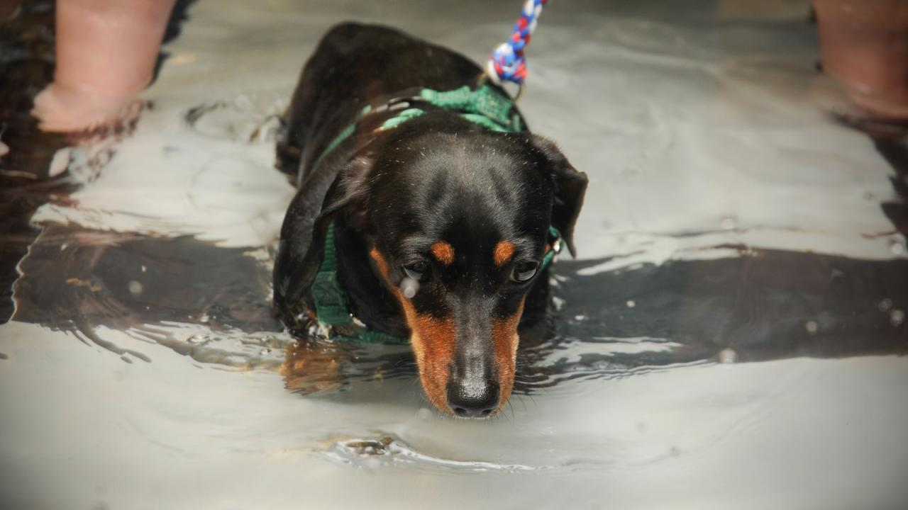
Fourth Year Clinical Rotations
Required Core: Anatomic Pathology, Clinical Pathology, Primary Care Medicine, Referral Medicine, Emergency Medicine, Anesthesia, Soft Tissue Surgery, Orthopedic Surgery, Radiology, Cardiology, Neurology, Oncology, Ophthalmology
Optional Electives: Integrative Medicine, Sports Medicine
Individual Externships
Notes:
While not all students will take integrative medicine, this rotation averages about 80 student weeks per year, meaning there is essentially 1 student on each week. In equine sports medicine, this is about 30 student weeks per year. While I can only speak about orthopedic surgery, we discuss the importance and use of physical rehabilitation for our orthopedic patients, so the graduating students are well aware of the need and expected outcome following PT for many orthopedic disorders.

Slide 8
UC Davis Sports Medicine and Rehabilitation Service
Treatment techniques include:
Manual therapy
Manual techniques to facilitate or inhibit muscle contractions
Soft tissue mobilization
Therapeutic massage
Modalities for pain, inflammation and swelling
Balance training
Gait training
Proprioceptive training
Strength and conditioning
Hydrotherapy
Home environment recommendations
Videotape analysis of movement
Custom orthotic fabrication
https://www.vetmed.ucdavis.edu/hospital/small-animal/sports-medicine-rehabilitation
Notes:
Manual therapy includes massage and chiropractic work

Slide 9
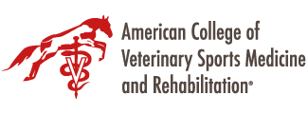
Developed to meet the unique needs of athletic and working animals as well as all animals in need of rehabilitation.
Rehabilitation (the term used for people is “physical therapy”) not only focuses on recovery after surgical procedures, but also on improving the quality of life in animals suffering from debilitating diseases such as arthritis or neurologic impairments.
Objectives:
  State-of-the-art veterinary care in the field of veterinary sports medicine and rehabilitation.
  Collaboration with educational institutions including the development and credentialing of residency programs.
  Research advancing scientific knowledge in the field of veterinary sports medicine and rehabilitation.
  Continuing education for veterinarians, students, and owners/handlers of pets, animal athletes, and working animals.
  Public awareness of the benefits of working with certified specialists in veterinary sports medicine and rehabilitation.

Slide 10
American College of Veterinary Sports Medicine and Rehabilitation
Only available to veterinarians
One of 22 nationally recognized veterinary specialty organizations accredited by then AVMA’s American Board of Veterinary Specialties
After veterinary school, veterinarians who wish to seek ACVSMR diplomacy must:
  Complete a one-year rotating internship
  Complete a three-year residency training program at an approved institution
  Publish research
  Pass a rigorous credentialing examination

Slide 11
  Why is a “certification” (e.g. obtained at the Florida school by a human physical therapist) not an appropriate level of understanding of animal anatomy?
Certification has no accreditation, continuity or minimum standards between programs
Certification has neither aptitude testing nor CE requirement
From the previous slides, to understand the “why” in addition to the “how” one must have a far more extensive education than what a certification can provide
Humans are physiologically not equivalent to other animals like dogs or horses- there are vast differences in everything from their comparative physiology and anatomy to their behavior

Slide 12
What are some important differences between people and animals?
Transition from young to adult within 1-2 years instead of 18-20 years
  Rapid growth can lead to skeletal growth deformity and/or muscle contracture in the face of undiagnosed injury
Recognition of pain is not straightforward
Significant difference in position of spine
Even among different animal species, direct parallels cannot always be drawn
  A cat is not a small dog, and a big dog is not a small horse
  Thus, is takes more than a few weeks to gain full understanding on species differences
Notes:
For example, a not uncommon spinal abnormality in small dogs is an instability between 2 vertebraes in the neck. A sudden movement in that area can lead to acute death. Thus, recommending treatment without having the correct diagnosis, established by a veterinarian using x-rays and MR, can be detrimental to the health of the patient. While a clear and thorough understanding about the human body may be present, this does not directly translate to the body of a cat, or a dog.

Slide 13
Chiropractic treatment in animals
There are many dog breeds that have inherent malalignment and malformation of the spine
  Adjustments in these dogs can dramatically worsen the function
  Unlike people, dogs with disc disease are often more neurologically affected compared to people
  Having a thorough understanding of the species and breed differences along with the correct diagnosis before treatment is vital to perform these treatments safely
Notes:
Idiopathic lameness, intervertebral disc disease, Wobbler syndrome/cervical vertebral malformation, spondylosis, cauda equina syndrome, urinary incontinence, neuropathies, postsurgical rehabilitation, trauma, and various organ pathologies; many of these may actually constitute contraindications for the use of chiropractic treatment.

Slide 14

Continuing Education for Veterinarians
Several opportunities offered throughout the year at veterinary CE conferences, online learning platforms, and educational programs. A few current examples are:
VMX, Orlando, January each year
CVMA Pacific Veterinary Conference, yearly
University Tennessee, CRI, and other programs which offer PT education
Notes:
In California, a veterinarian must complete 36 hours of continuing education to renew their license. This ensures that they stay current on treatment recommendations and best practice with it comes to diagnosis of animals. It’s important to recognize that In California, only licensed veterinarians are legally qualified to diagnose and treat animals, including prescribing medications and performing surgeries.
Physical rehabilitation and chiropractic work is a type of treatment that is recommended based on a diagnosis, this a veterinarian should be involved.
Certificate program in companion animal rehabilitation / see https://www.rehabvets.org/training.lasso
- Tennessee Program
- Canine Rehabilitation Institute (Wellington, Florida)
- Healing Oasis (Sturtevant, Wisconsin)
- Curacore Vet (Fort Colling Colorado)
- Integrative Veterinary Medical Institute (Ocala, Florida)

